Slide 1
CSCE 093
BattleShip Coding Project – Get Started

Slide 2
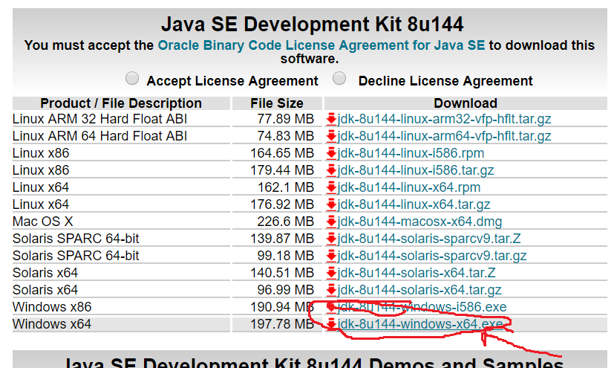
Download the Java JDK.

Slide 3
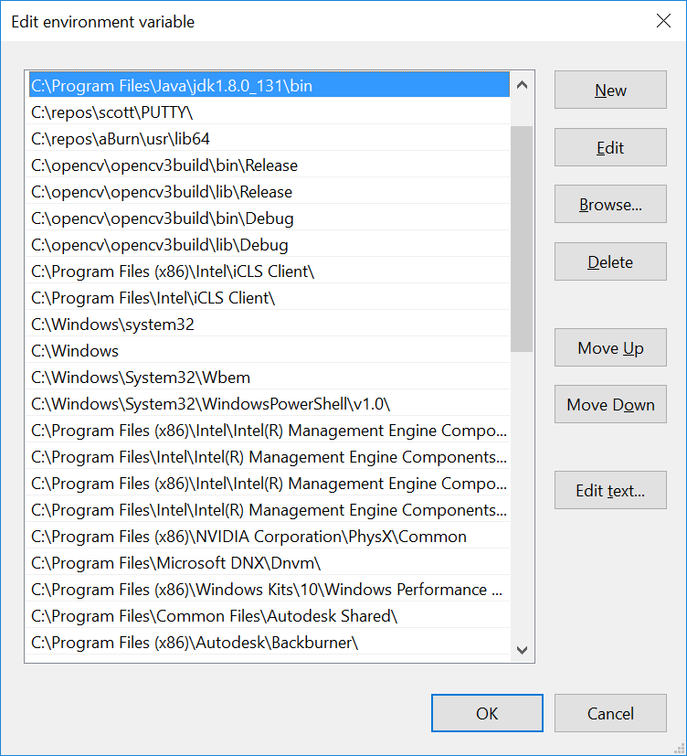
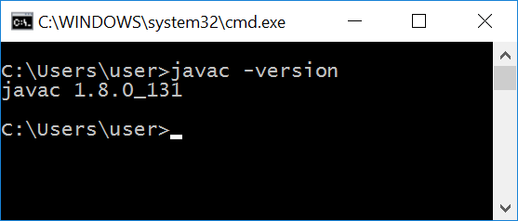
Add javac to path
The open CMD window and check path. Note: Your latest version may end with a different number (like _144).

Slide 4
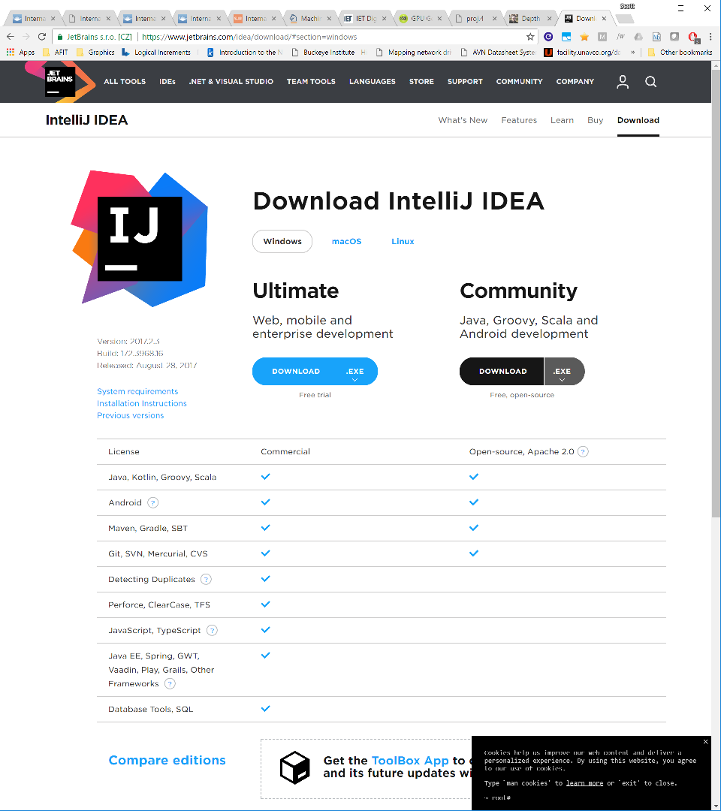
Install Intellij IDEA (IDE Environment for java)

Slide 5
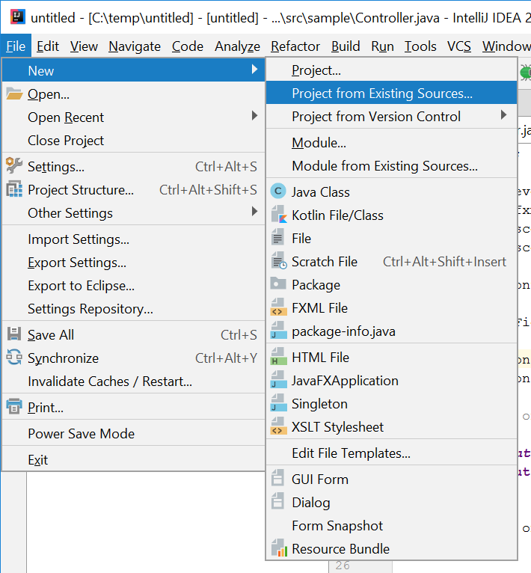
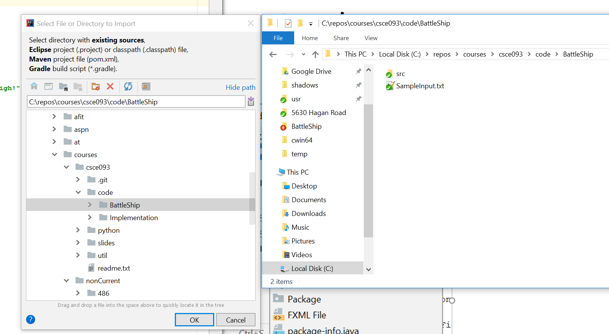
Import Existing Source Code

Slide 6
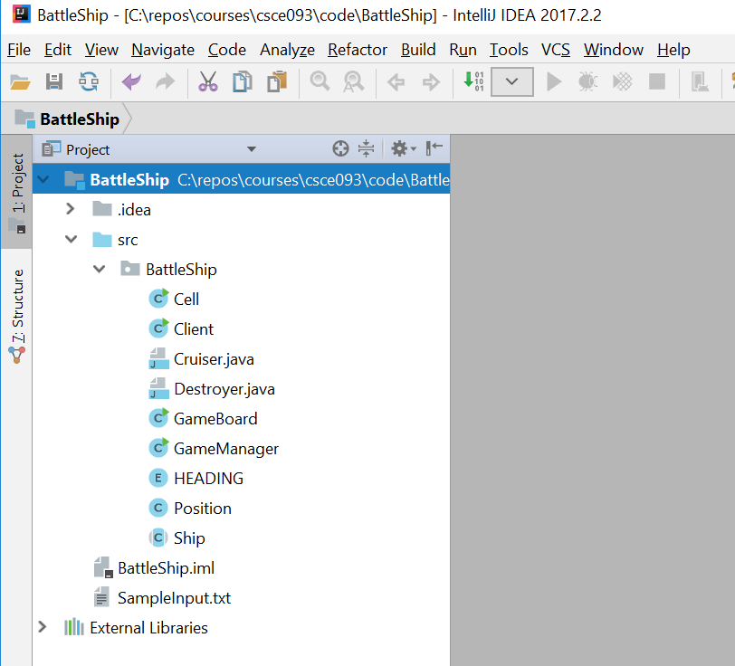
Click “Next” 7 times until project is imported
If asked, set your JDK to Java JDK 1.8 – This should be discovered automatically after properly installing the JDK and adding it to your path.

Slide 7
Write Code!
You will have to look through all source files and implement all code sections / classes that are not complete.
When completed, you can launch the main program by opening “GameManager.java” and pressing SHIFT-F10.
Read all files, comments, and methods.
You’re in grad school now, your hand is not being held – figure out the structure, and write java code to create your battle ship game.

Slide 8
How to Play Battleship
When you run GameManager, a server instance will start on your local machine. Alternatively, you can simply launch my implementation as java .jar file from a console window by double clicking “Launch Dr Nykls Version.bat”
This lets you test the behavior of a fully working implementation of Battleship to see how your implementation should behave.
Two Clients will joint in using PuTTy
See “SampleInput.txt” for an example set of valid input commands two players may enter as they battle each other.
Run the server and play a few games to understand what’s happening before trying to write code.

Slide 9
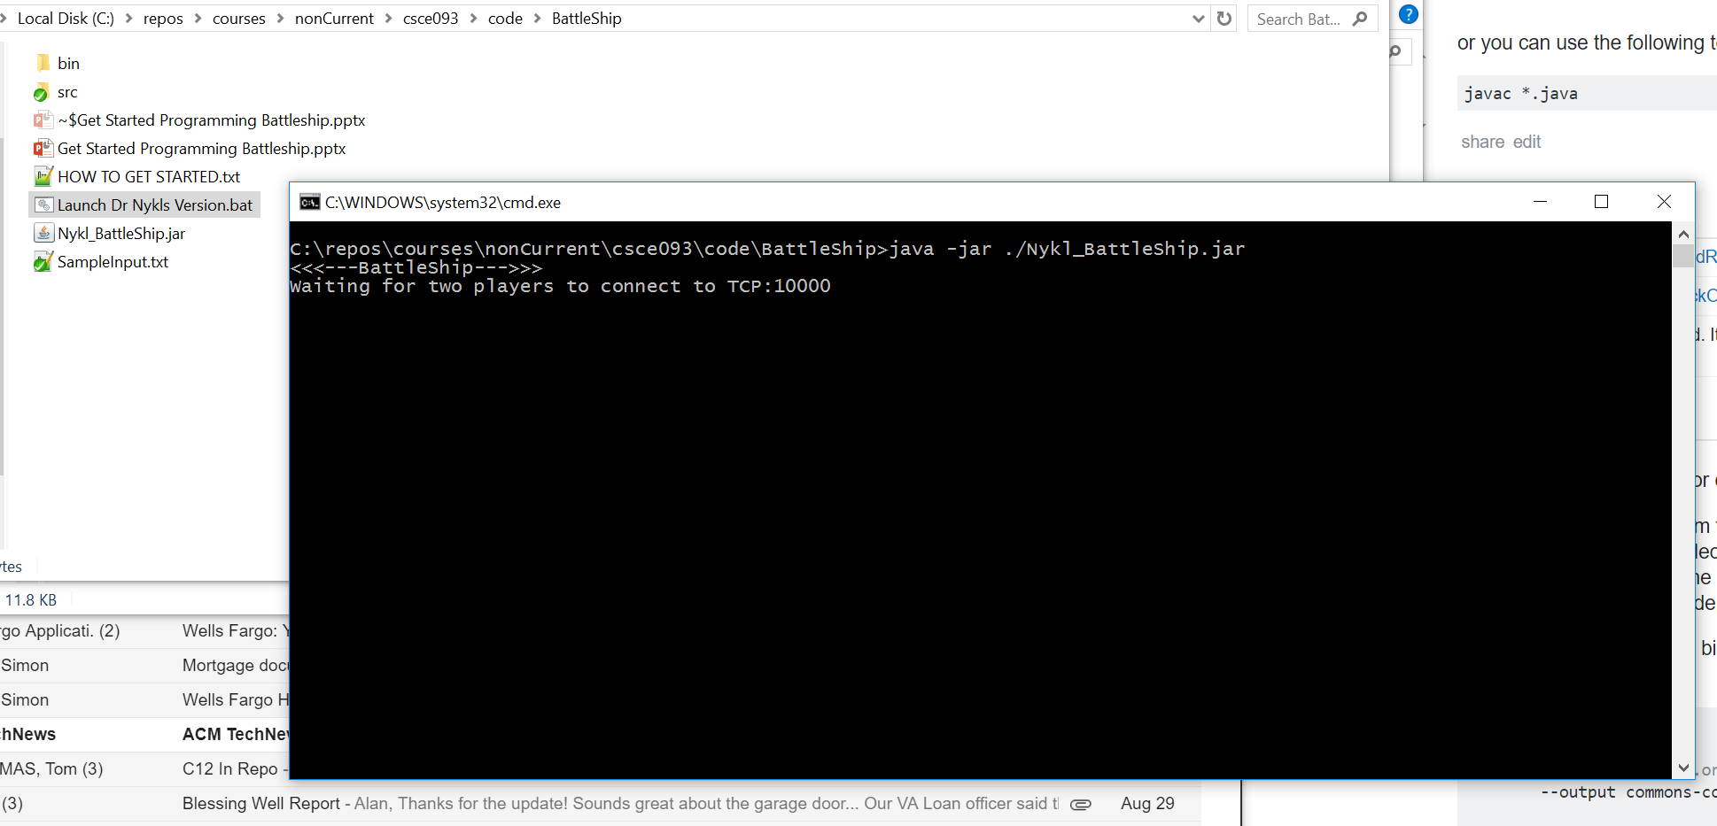
Run the Server

Slide 10
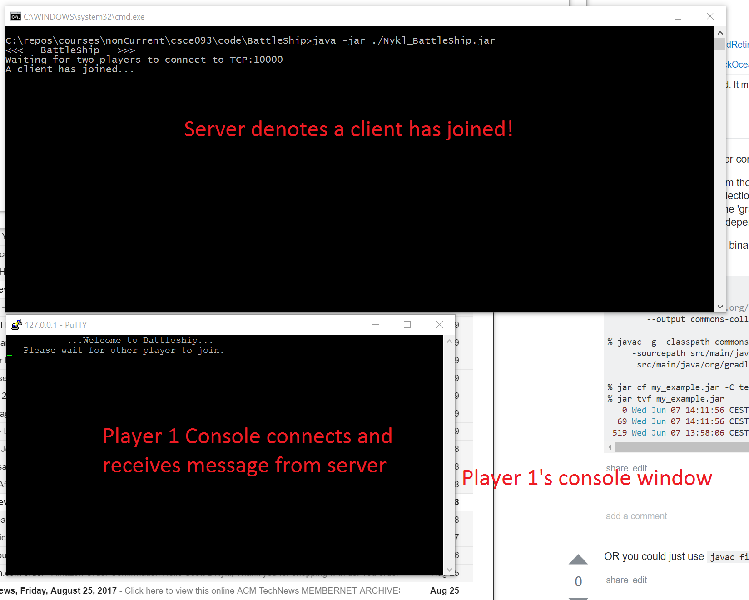
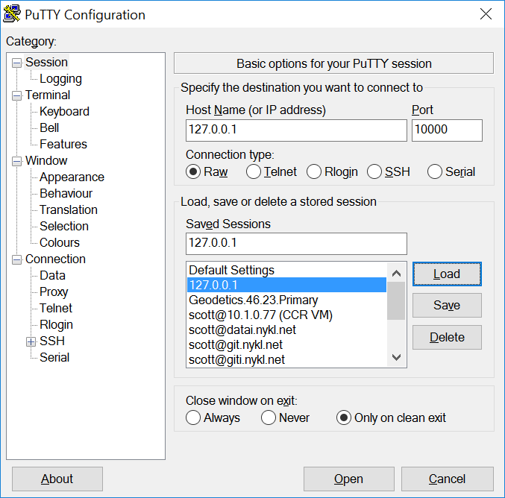
Connect Client 1

Slide 11
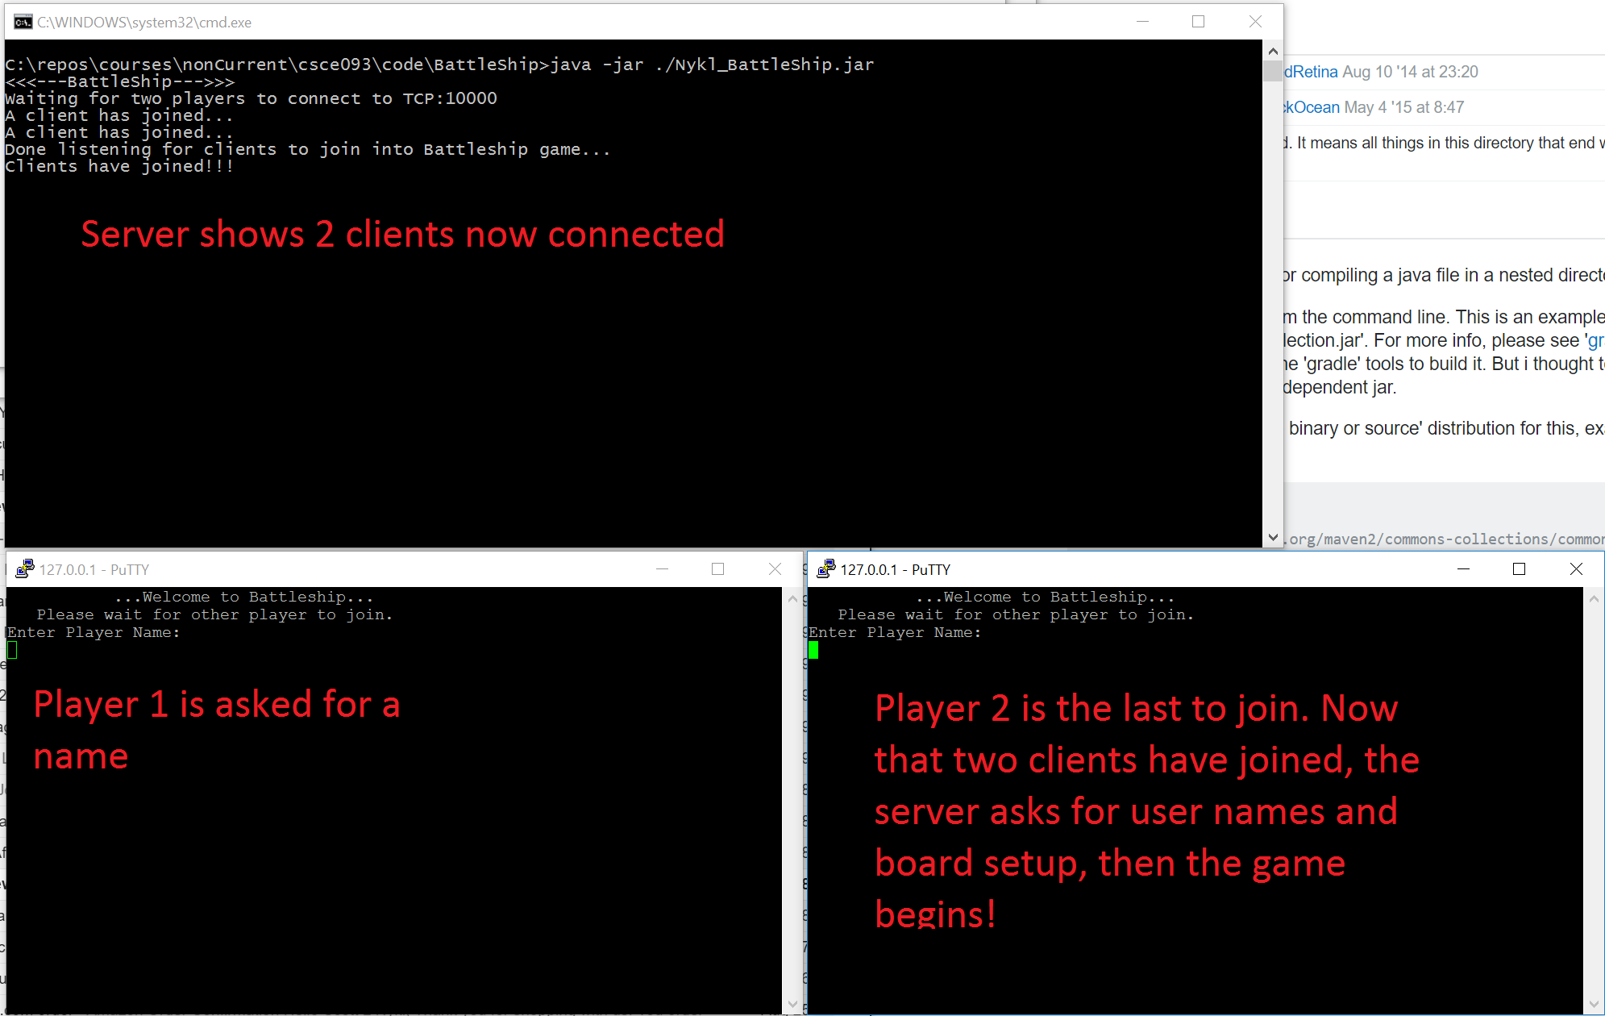
Connect Client 2 (Run another instance of PuTTY and Connect to server a second time

Slide 12
Sample Input from Each Player (SampleInput.txt)
Player A
D 2 4 S DestroyA
C 3 5 N CruiserA
F 0 0
F 1 0
F 2 0
F 0 1
F 1 1
F 2 1
F 3 1
Player B
D 0 0 E DestroyB
C 0 1 E CruiserB
F 9 9
F 10 10
F 9 8
F 2 4
F 2 5
F 2 6
F 3 5
F 3 2
F 3 3
F 3 4

Slide 13
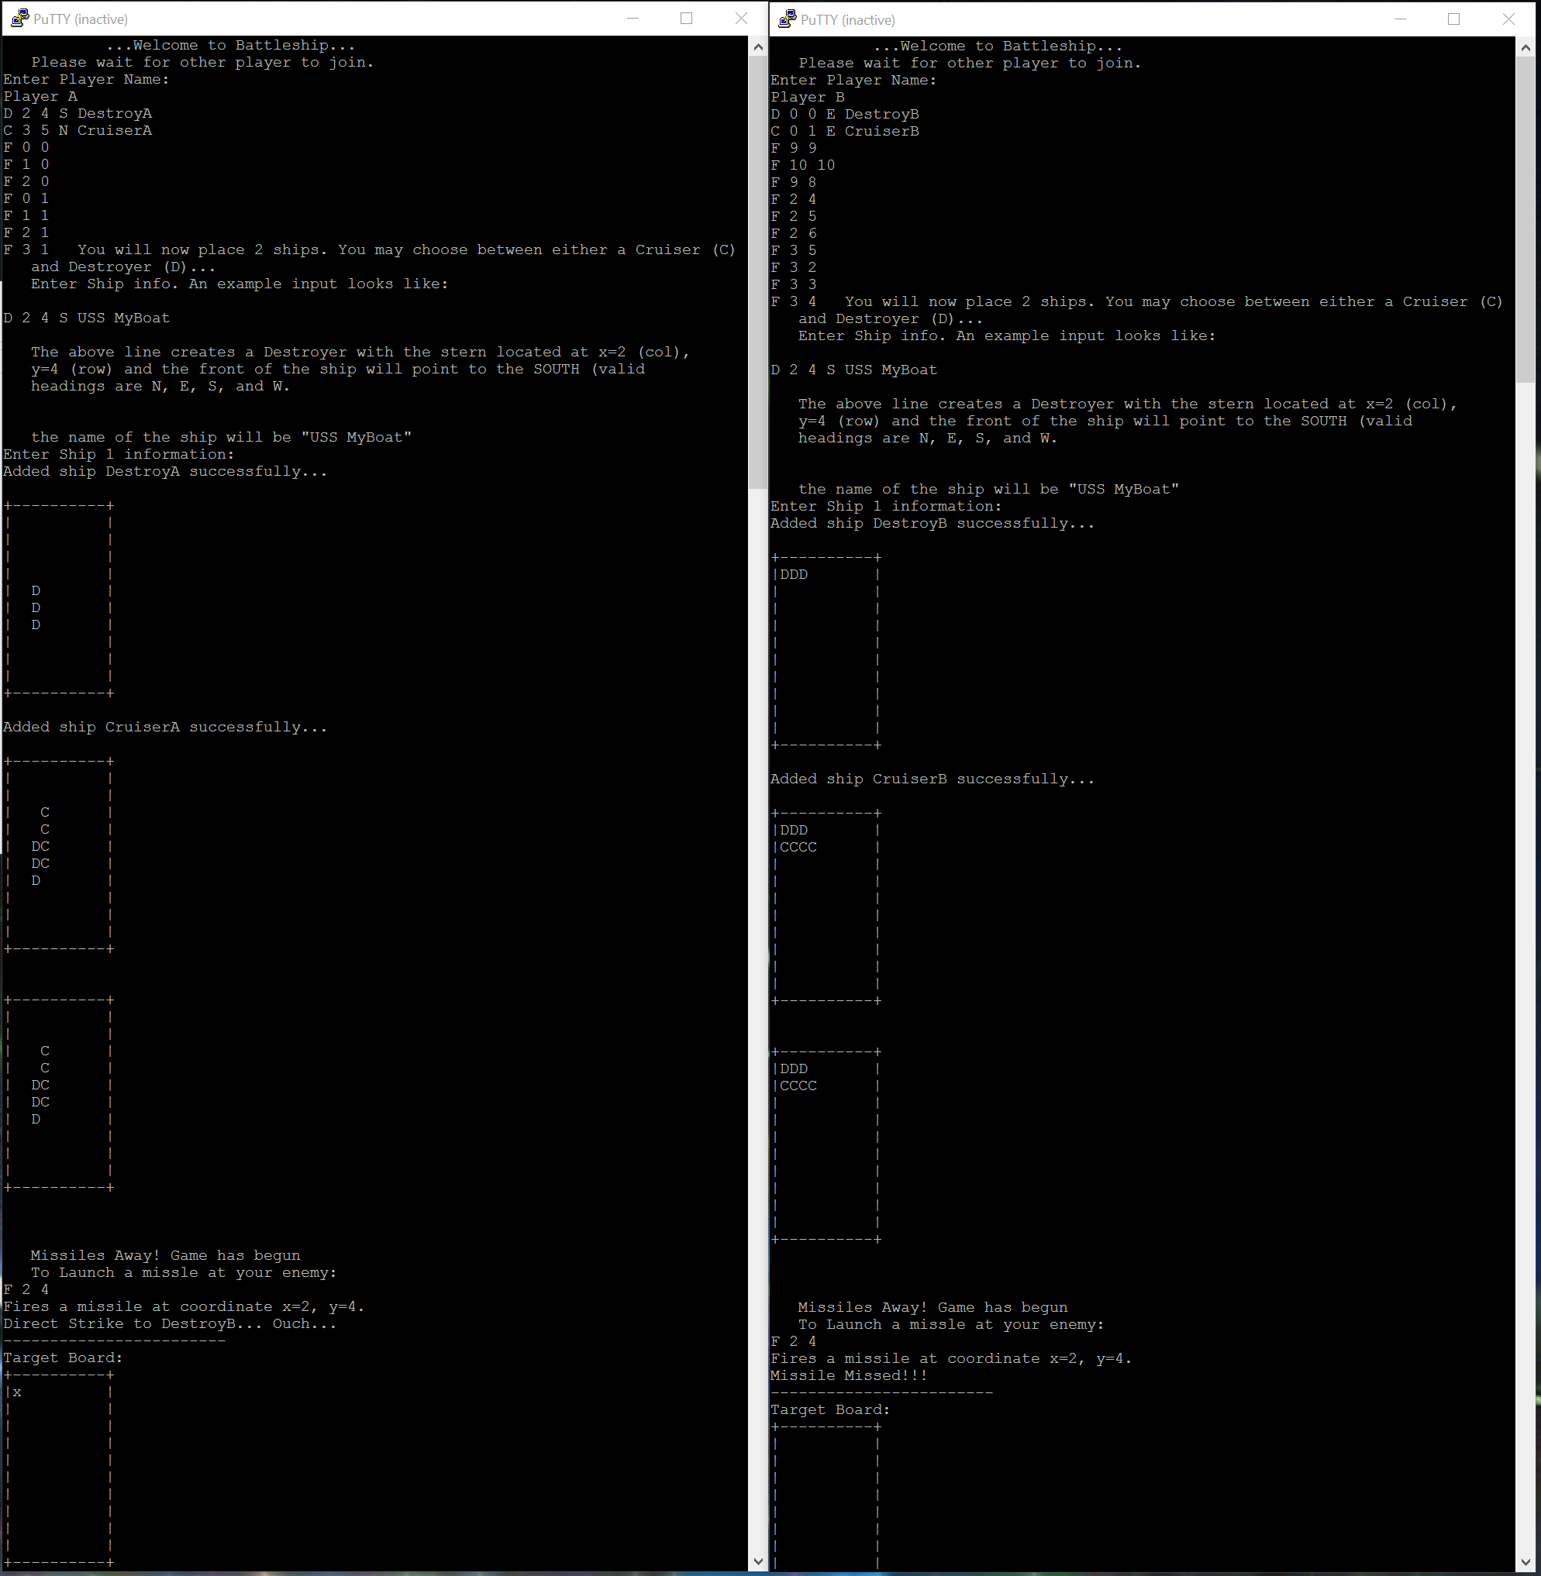
Player 1 vs Player 2
Ensure you play against yourself several times before attempting to write source code. You will have to infer the software design and structure of the source code based on the behavior of the program.

Slide 14
Input can be typed one line at a type. Each Player can do this independently.
See PlayerA.log & PlayerB.log
Shows the board setup and each command.

Slide 15
On Your Own
Complete the code skeleton to make your own Battleship server that lets two player interactively compete against one another simultaneously!
Since it’s networked, you can play this across the internet!

Slide 16
Python
After Battleship, Go through the python slides, too!
Use Python to write a regular expression tool that can refactor.py the input in /python/refactor/test

